Slide 1

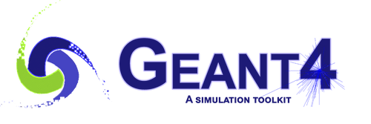

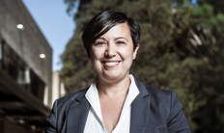


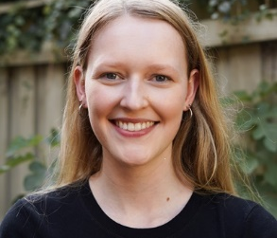
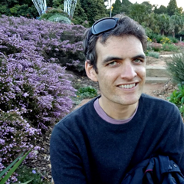

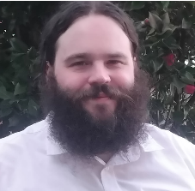






World Congress on Medical Physics and Biomedical Engineering
Geant4 Workshop for Medical Physics
October 1, Wednesday
Geant4 is an open-source Monte Carlo radiation physics simulation code, extensively used in medical physics, including verification of radiotherapy treatment planning systems, and the design of equipment for radiotherapy and nuclear medicine. It is also used in medical imaging for dosimetry, to improve detectors and reconstruction algorithms, and for radiation protection assessments. Geant4 can be used in stand-alone applications or via software tools like GAMOS, GATE, PTSim, and TOPAS. This workshop will provide an overview of Geant4 capability of interest for medical applications, then, realistic applications of the Toolkit will be illustrated in X-ray radiotherapy, hadron therapy, imaging, nuclear medicine, radiation shielding and radiobiology.
Speakers
Prof Susanna Guatelli
International leading expert of Monte Carlo radiation transport simulation codes for radiation physics.
A/Prof Michael Douglass
A/Prof Alex Santos
Principal Medical Physicist at the Royal Adelaide Hospital and Associate Professor at the University of South Australia.
Senior Medical Physicist at Royal Adelaide Hospital Medical Physicist and Associate Professor at The University of Adelaide
Sherryn MacLeod
PhD candidate the University of Wollongong specialising in Geant4 modelling of neutron sources for medical applications.
Dr David Bolst
Associate Research Fellow at the University of Wollongong
Christopher White
A/Prof Scott Penfold
PhD candidate the University of Wollongong researching Monte Carlo based Radiotherapy simulations for the generation of ML based dose prediction models.
Lead Medical Physicist of the Australian Bragg Centre for Proton Therapy and Research, and an Affiliate Associate Professor in Medical
World Congress on Medical Physics and Biomedical Engineering
29 September - 4 October 2025
Adelaide Convention Center, Australia
https://wc2025.org

